Slide 1

Predicting Myocardial Infarction: A Comparative Analysis of Regression Models on Clinical Data and Image-Based Classification of ECG Patterns

Slide 2

MYOCARDIAL INFARCTION: A Global LIFE THREAT
Myocardial Infarction (MI) is one of the leading causes of death worldwide.
According to Rohani et al. (2022), 18.8% of the patients hospitalized with MI diagnosis pass away, making it a major public health concern.
Early diagnosis can significantly reduce the risk of MI and prevent possible death in patients.
Machine learning can analyze vast amounts of patient data, uncover hidden patterns, and predict the likelihood of MI more accurately than traditional methods.

Slide 3

Previous work
Pham et al. (2023) compare different models on ECG images with the aim to form a model that can read these images without the need for human intervention. Our study uses this concept to raise the question: are ECG images enough for prediction of MI, or do the results improve significantly if patient vitals are introduced.
Velusamy et al. (2024) leverage clinical, demographic and laboratory data to predict MI in patients using 5 classifiers: Naive Bayes, SVM with Linear Kernel, Logistic Regression, and SVM with Gaussian Kernel. The research uses the Cleveland Clinic Heart Disease Dataset
Piros et al. (2020) use Hungarian Myocardial Infarction Registry analyze myocardial infarction outcomes using 5 models each for 30-day mortality and 1-year mortality with the AUC ranging from 0.817 to 0.844. Our project focuses on using minimal data with highly relevant features for a lower model complexity
Dr. Taha et al. (2022) aim to assist healthcare providers in detecting heart diseases. They use SOM, Naive Bayesian, Random Forest, SGD, Multilayer Perceptron, Adaboost, and Logistic Regression using the Heart Stalog Dataset. The goal is to improve the performance of classifiers using HAS for effective feature extraction.
Notes:
Our project uses a dataset that combines common features of multiple datasets like Cleveland etc.

Slide 4
Dataset 1: Heart Disease (Statlog Cleveland and Hungary)
1190
Classes: 2 (Presence or absence of heart disease)
Features: 12 attributes, including age, sex, chest pain type, resting blood pressure, cholesterol, fasting blood sugar, rest ECG, max heart rate, exercise-induced angina, and ST depression.
Examples: 1190 data points, 12 columns
Advantages: structured, tabular data, derived from clinical tests
Source: Heart Disease Dataset on Kaggle
Previous Use: This dataset has been widely used in various machine learning models to predict heart disease, including logistic regression, decision trees, and neural networks. It has been cited in studies focusing on CVD risk assessment using machine learning algorithms.

Slide 5
Dataset 1: Heart Disease (Statlog Cleveland and Hungary)
age | sex | chest pain type | resting bp s | cholesterol | fasting blood sugar | resting ecg | max heart rate | exercise angina | oldpeak | ST slope
40 | 1 | 2 | 140 | 289 | 0 | 0 | 172 | 0 | 0 | 1
49 | 0 | 3 | 160 | 180 | 0 | 0 | 156 | 0 | 1 | 2
37 | 1 | 2 | 130 | 283 | 0 | 1 | 98 | 0 | 0 | 1
48 | 0 | 4 | 138 | 214 | 0 | 0 | 108 | 1 | 1.5 | 2

Slide 6
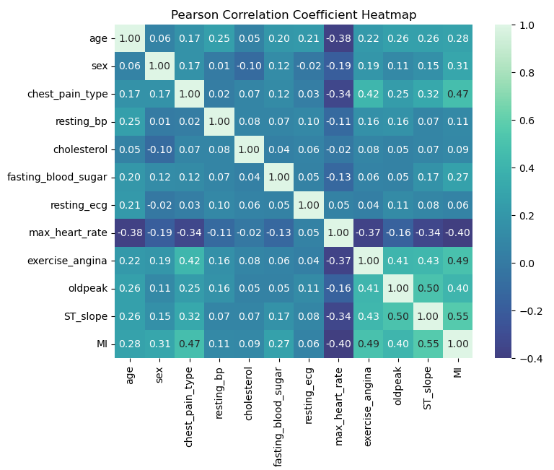
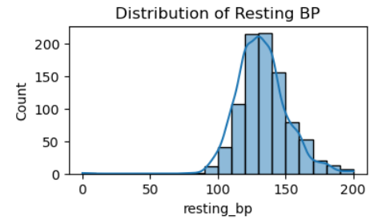
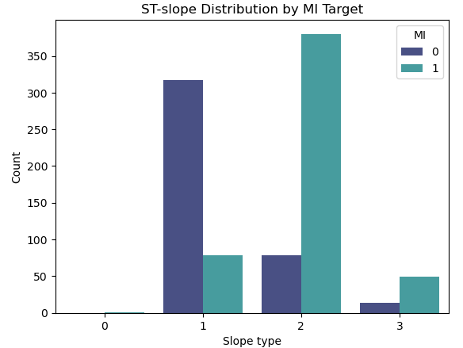
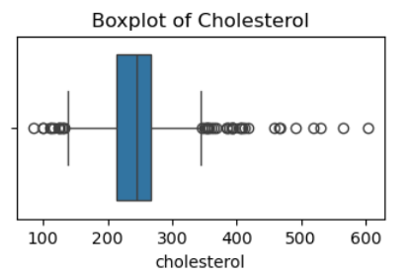
Dataset 1: Visualization

Slide 7
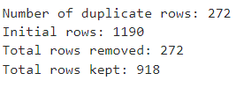
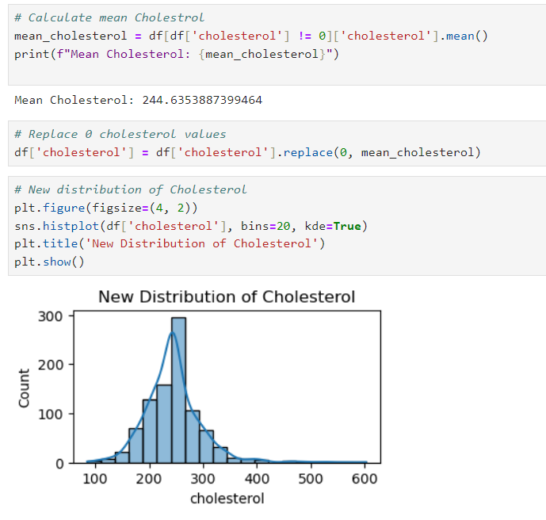

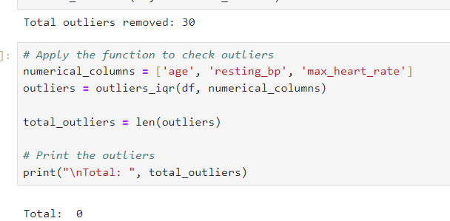
Dataset 1: Pre-processing
Duplicate rows removal
Cholesterol 0 values replaced:
Split train, test, and validation:
Removing outliers:

Slide 8
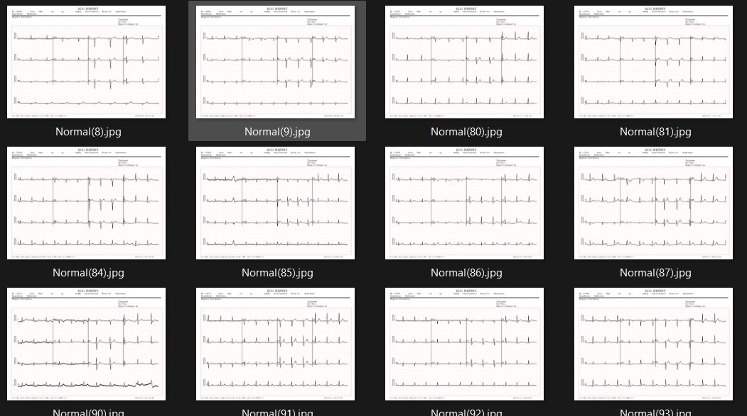
Dataset 2: ECG Image Dataset
Classes: 2 (Normal vs. Abnormal ECG readings)
Features: Image data representing ECG waveforms.
Examples: Thousands of ECG images with labels indicating normal or abnormal heart activity.
Advantages: ECG readings are a primary diagnostic tool for detecting heart conditions, automatically detect abnormalities, quicker diagnoses
Source: ECG Image Dataset on Kaggle
Previous Use: This dataset has been used in image classification models, specifically convolutional neural networks (CNNs), to detect heart conditions from ECG images. Research in this area has demonstrated high accuracy rates for models trained on these types of datasets.

Slide 9
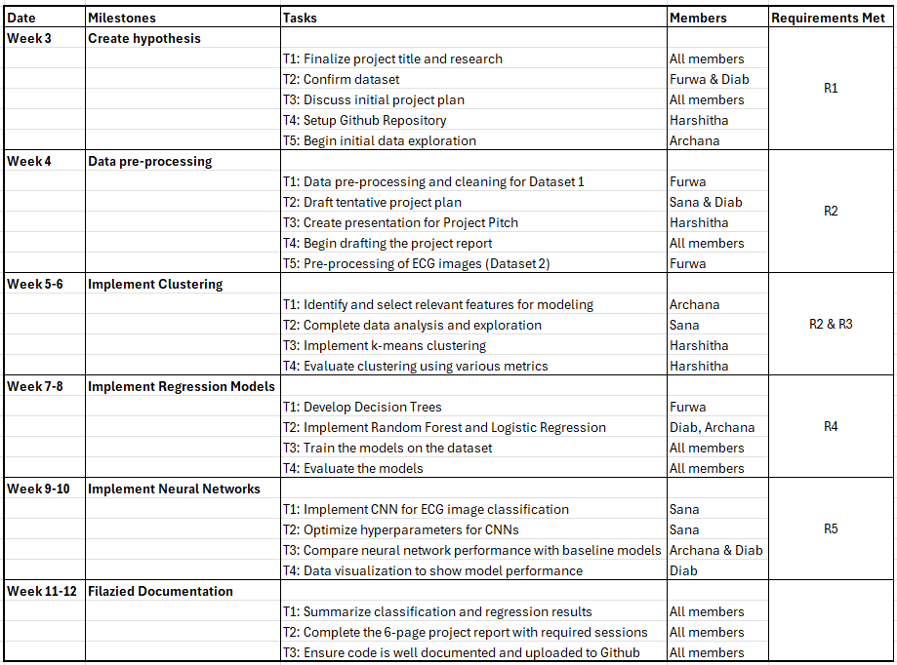
Tentative Timeline

Slide 10
REFERENCES
Rohani C, Jafarpoor H, Mortazavi Y, Esbakian B, Gholinia H. Mortality in patients with myocardial infarction and potential risk factors: A five-year data analysis. ARYA Atheroscler. 2022 May;18(3):1-8. doi: 10.48305/arya.v18i0.2427. PMID: 36815954; PMCID: PMC9931944.
Pham H, Egorov K, Kazakov A and Budennyy S(2023) Machine learning-based detection ofcardiovascular disease using ECG signals: performance vs. complexity. Front. Cardiovasc. Med. 10:1229743. doi: 10.3389/fcvm.2023.1229743-
A. Velusamy, J. Akilandeswari, S. Vaanathi, M. Priya, T. Munirathinam and S. Kokila, "Enhancing Myocardial Infarction Prediction with Machine Learning: Leveraging Clinical and Demographic Data for Improved Early Detection and Patient Outcomes," 2024 OPJU International Technology Conference (OTCON) on Smart Computing for Innovation and Advancement in Industry 4.0, Raigarh, India, 2024, pp. 1-6, doi: 10.1109/OTCON60325.2024.10687656.
P. Piros, R. Fleiner, and L. Kovács, "Finding improved predictive models with Generalized Boosted Models on Hungarian Myocardial Infarction Registry," 2020 IEEE 20th International Symposium on Computational Intelligence and Informatics (CINTI), Budapest, Hungary, 2020, pp. 179-184, doi: 10.1109/CINTI51262.2020.9305814.
M. A. Taha, S. A. A. A. Alsaidi and R. A. Hussein, "Machine Learning Techniques for Predicting Heart Diseases," 2022 International Symposium on iNnovative Informatics of Biskra (ISNIB), Biskra, Algeria, 2022, pp. 1-6, doi: 10.1109/ISNIB57382.2022.10076238.

Slide 11
Any Questions?

